Slide 1

Projects Using React.js & Flux
Project 1: Bootstrap Components

Slide 2
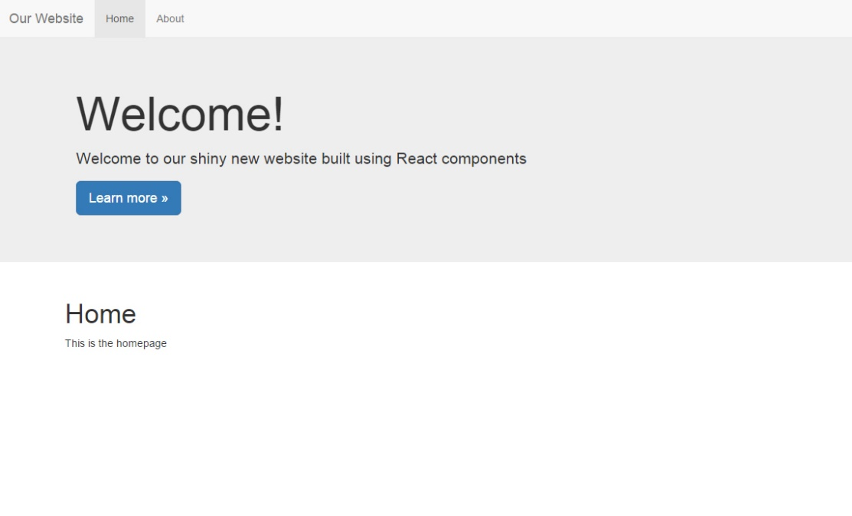
Project Description
We will take the markup for the Bootstrap NavBar and Jumbotron and turn them into React components with props, states and more

Slide 3
Project Lectures
Section Intro
Setup React & Bootstrap
Creating React Components
Component Props
Working With State

Slide 4
What You Will Learn
How to setup a simple react component
How to use props and propTypes
How to use state
Lifecycle methods

